Slide 1
Precision Welfare: Using AI to Deliver India's Social Safety Net
IBM AICTE PROJECT
Presented By:
Student name : Moubani Singha
College Name & Department : The Neotia University
CSE(Data Science)

Slide 2
OUTLINE
Problem Statement
Technology used
Wow factor
End users
Result
Conclusion
Git-hub Link
Future scope
IBM Certifications

Slide 3
Problem Statement
For India's elderly, widowed, and disabled citizens in BPL households, the NSAP is not just a policy— it's a promise of dignity and survival. Yet, this promise is often broken by a cumbersome manual classification system where a single human error can lead to an applicant being denied or delayed essential financial support.
Solutions
We propose to bridge this gap by developing an intelligent, automated system. By leveraging a multi-class classification model, we can instantly and accurately recommend the appropriate NSAP scheme, transforming a slow, error-prone process into a swift, data-driven system that ensures the right help reaches the right hands, right away.

Slide 4
Technology used
IBM Cloud AutoAI
IBM Watson Machine Learning
IBM Cloud Object Storage
Jupyter Notebook

Slide 5
IBM cloud services used
IBM Cloud Watsonx AI Studio
IBM Cloud Watsonx AI runtime
IBM Cloud Lite Services

Slide 6
Wow factors
Generates valuable analytics on applicant data to inform future policy.
This project transforms a slow, error-prone bureaucratic process into a high-speed, compassionate delivery system. It uses AI not just for technical efficiency, but as a tool for social justice, ensuring India's most vulnerable citizens receive the financial support they are entitled to without delay, directly upholding their dignity and right to a social safety net.
Unique Features:
Reduces applicant classification time from weeks down to mere seconds.
Drastically minimizes human error to ensure the correct aid is delivered.
Provides objective, data-driven recommendations to reduce manual bias.
Creates a digital blueprint to modernize welfare delivery nationwide.
.

Slide 7
End users
Government Administrative Staffs
NSAP Applicants(The Beneficiaries)
Social Welfare Departments & Policymakers
Auditors and Oversight Bodies

Slide 8
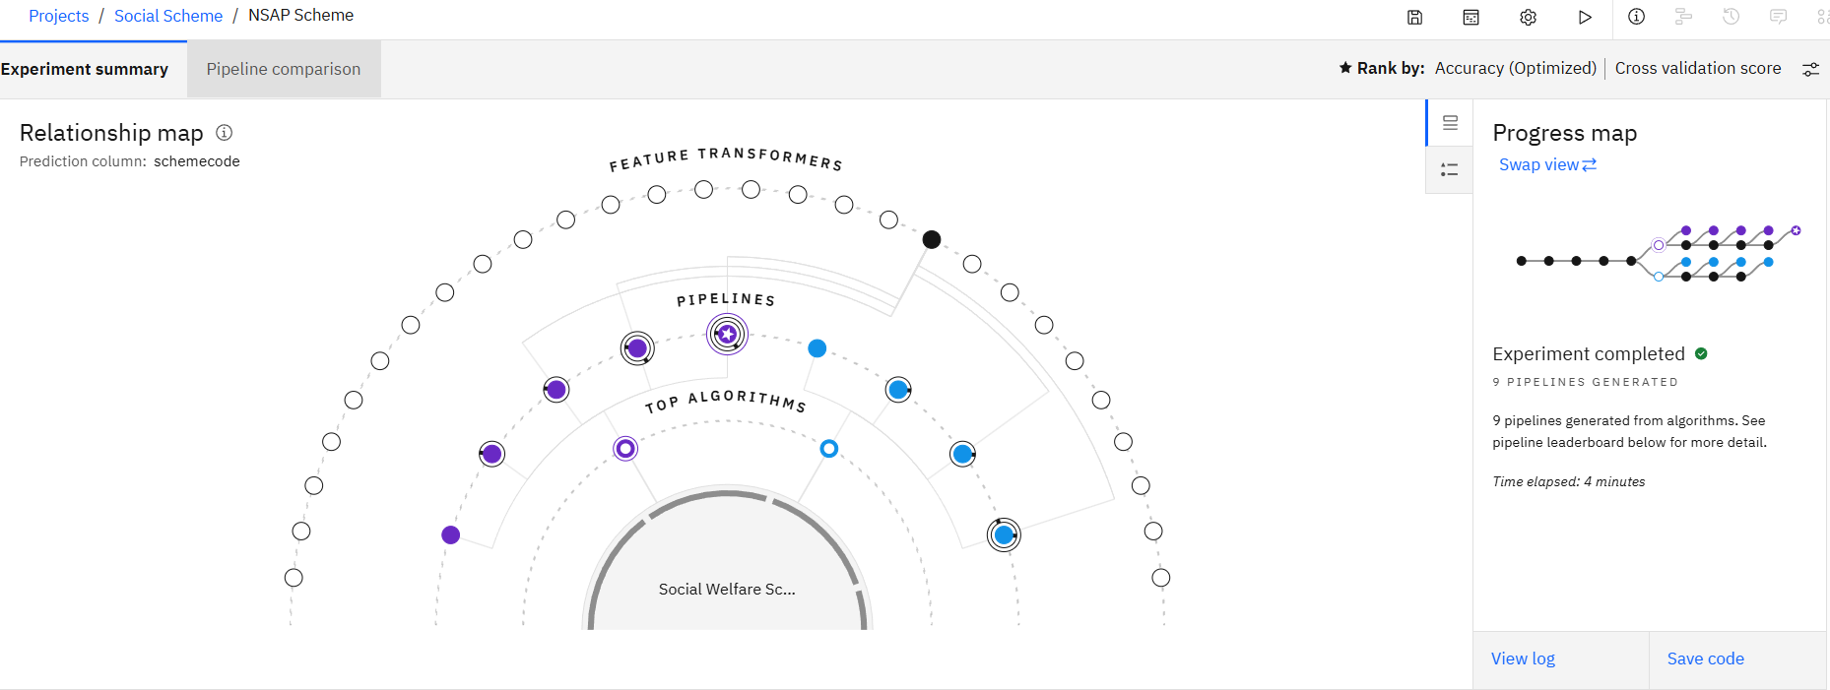
AUTOAI MODEL CREATION

Slide 9
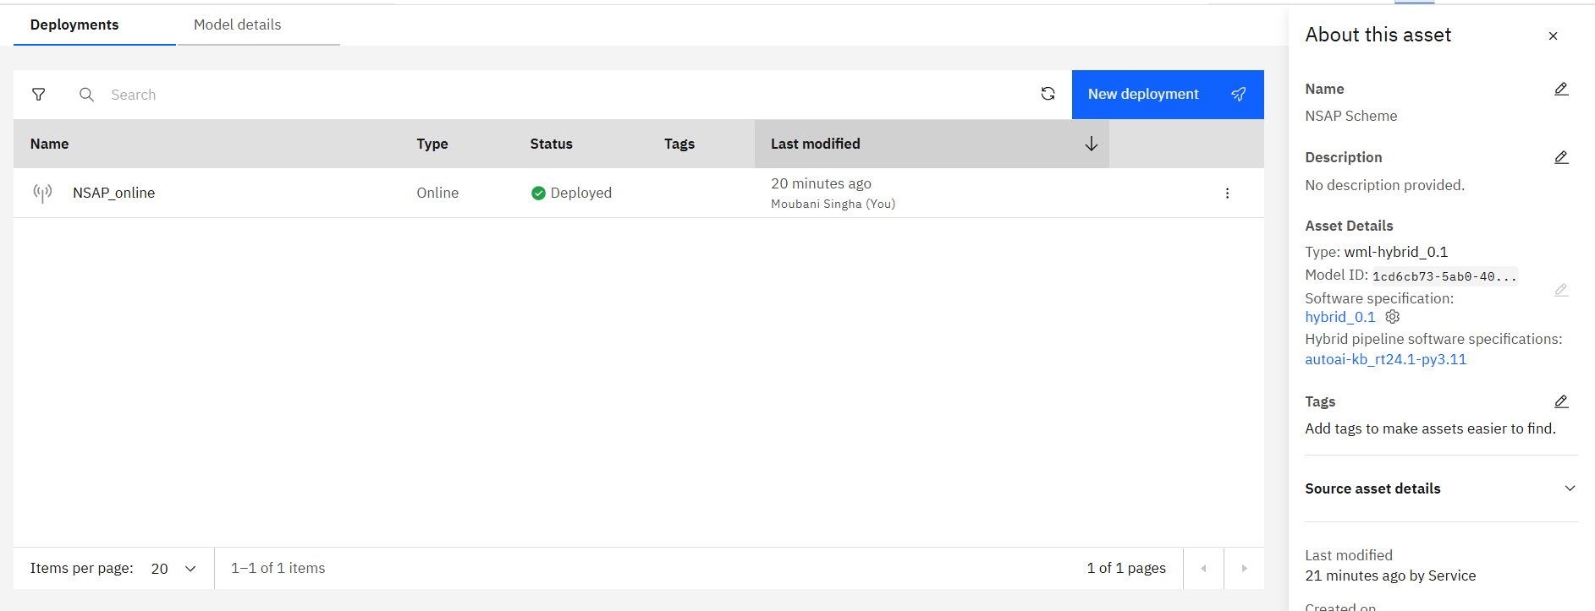
DEPLOYING the Model

Slide 10
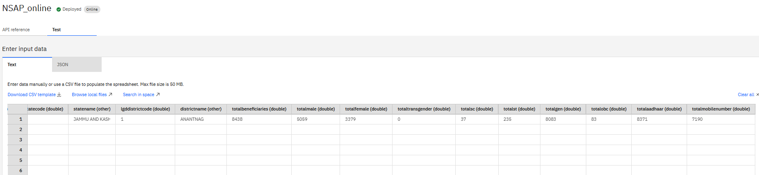
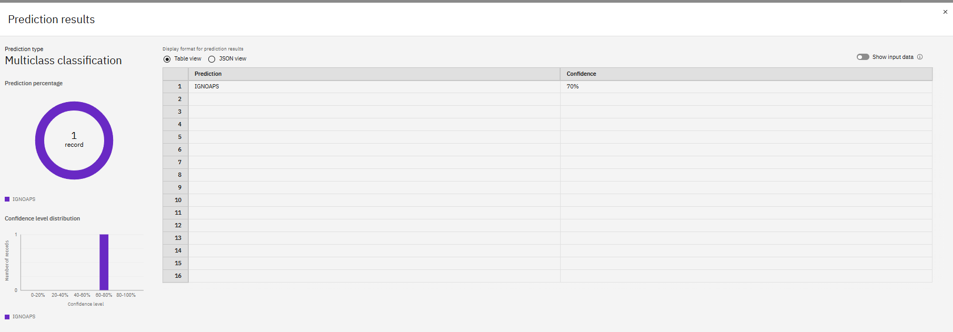
Predicting known values:

Slide 11
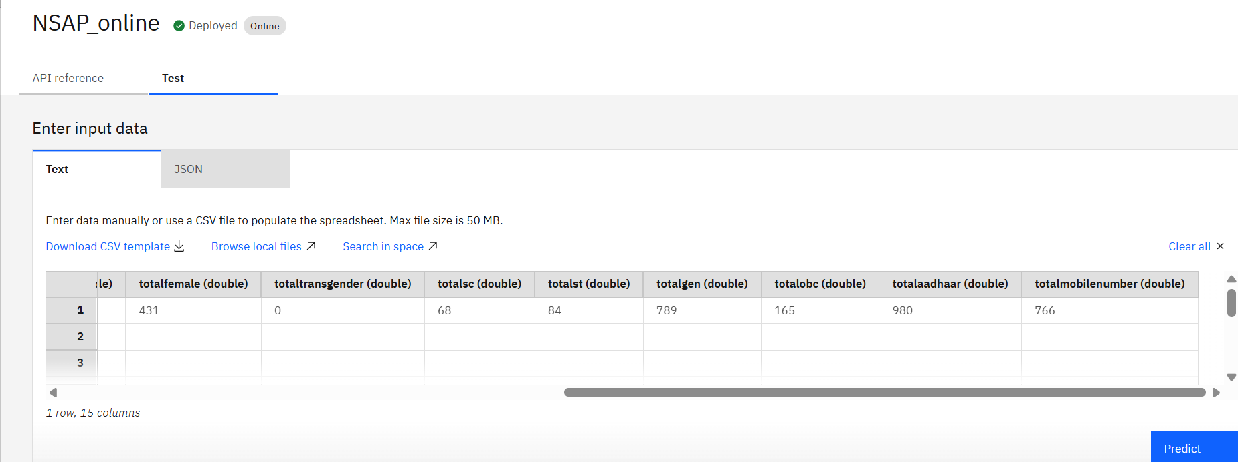
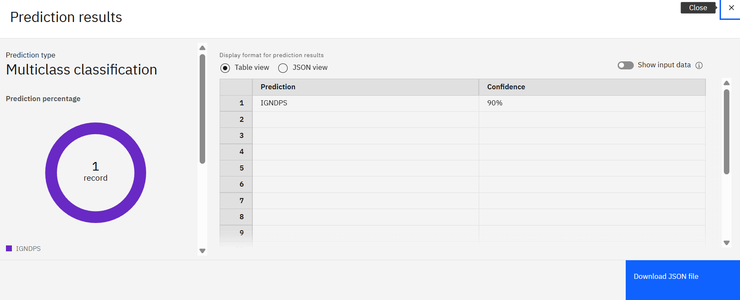
Predicting Unknown values :

Slide 12
Conclusion
A multi-class classification model was successfully developed to automate the assignment of NSAP schemes.
The model significantly reduces manual processing time and minimizes costly classification errors.
It ensures timely and accurate delivery of financial aid to the correct beneficiaries, including the elderly, widows, and persons with disabilities.
This provides government agencies with a reliable and efficient tool to improve the administration of social welfare programs.
The project successfully demonstrates how AI can be leveraged to create a more transparent, efficient, and impactful public service delivery system.

Slide 13
GitHub Link
https://github.com/moubanisingha/Social-Scheme-Prediction

Slide 14
Future scope
Explainable AI (XAI) Integration
End-to-End Process Automation
Fraud and Anomaly Detection
Multilingual and Voice-Based Support
Predictive Analytics for Policy Making
Automated Periodic Re-evaluation

Slide 15
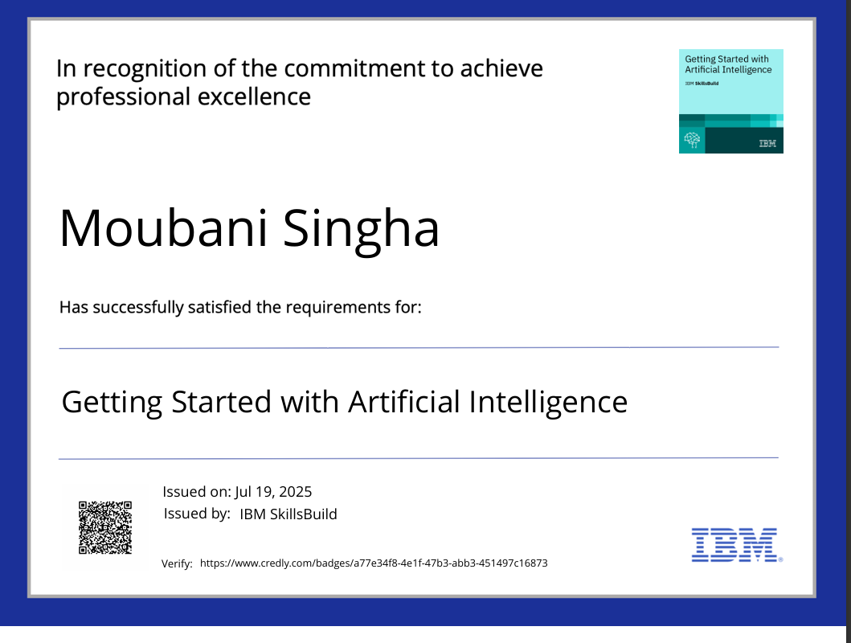
Getting Started with Artificial Intelligence

Slide 16
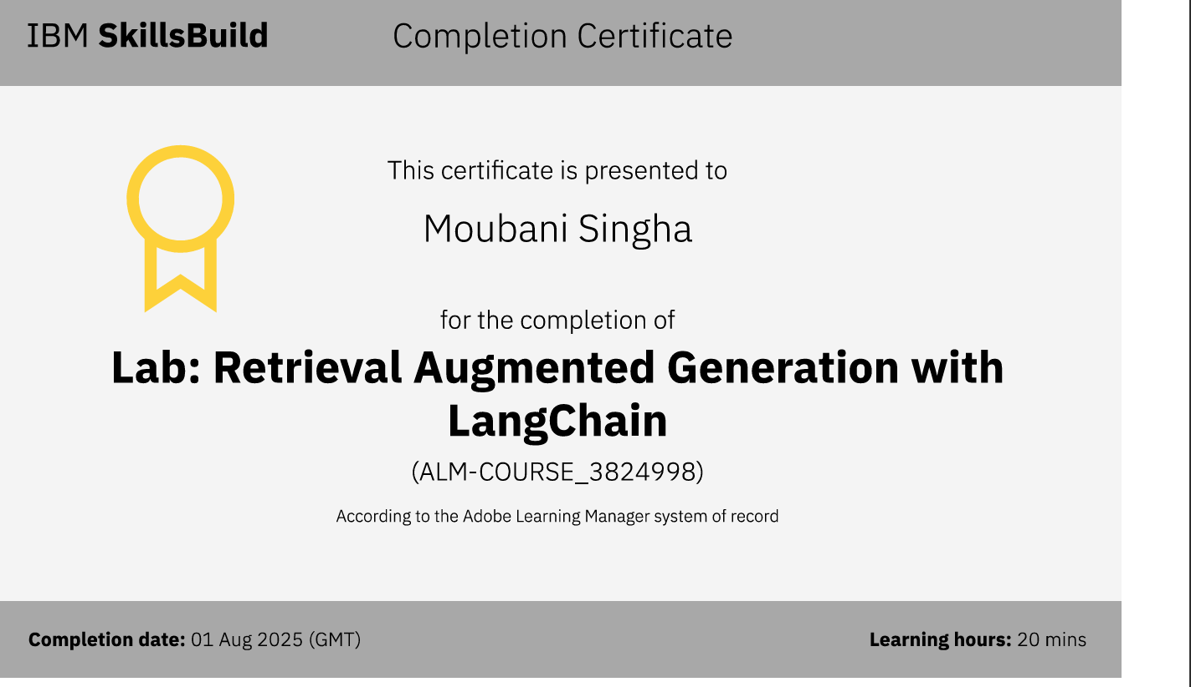

Slide 17
THANK YOU

